Slide 1
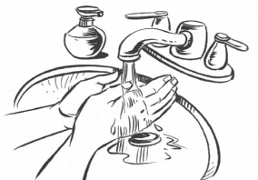
MTN-028 RING INSERTION INSTRUCTIONS
1
Wash your hands with soap and water and dry them on a clean cloth.
2
Get in the position that is most comfortable for you to insert the ring.
3
Hold and press the sides of the ring together. You may find it easier to insert the ring if you twist it into the shape of the number 8.
4
Use your other hand to hold open the folds of skin around your vagina.
5
Place the tip of the ring in the vaginal opening and then use your finger to push the folded ring gently into your vagina.
6
Push it up towards your lower back as far as you can. If the ring feels uncomfortable, it is probably not inserted far enough into your vagina. Use your finger to push the ring up as far as you can into your vagina.
7
The ring should now be in your upper vagina. Wash your hands when you are done. If you have trouble, contact the clinic or come in for assistance.

Slide 2
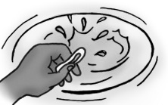
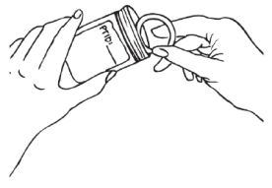
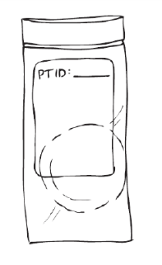
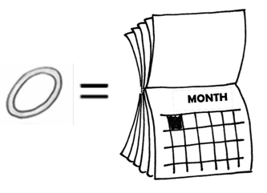
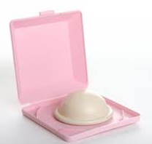
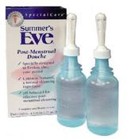
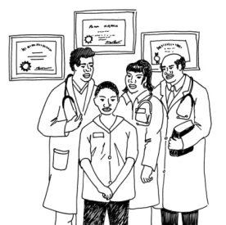
IMPORTANT INFORMATION
Leave the ring inserted, all day, every day: The ring should be kept inserted at all times including bathing and menses.
If the ring falls out or is taken out:
Somewhere clean: Rinse the ring in clean water (no soap) and try to reinsert it as soon as possible. If the ring is not immediately reinserted, rinse the ring and pat dry with a paper towel. Then, place the ring in the bag provided to you until you are able to reinsert it.
Somewhere dirty (such as the toilet): Do NOT reinsert the ring. Instead, place it in the return bag provided to you and contact the clinic to get a new ring.
Remove and Return: During your Day 28 visit, you will be asked to remove and return the ring. Try not to remove your ring prior to your day 28 visit. If you can not make it to the clinic for your visit, please contact study staff.
Avoid: Other than the ring, use of other vaginal products, devices, and certain medications should be avoided. You are also asked to abstain from receptive sexual activity (including penile-vaginal sex, anal sex, oral sex and finger stimulation). Note that tampons should not be used during the first week of participation, and for 24 hours prior to each visit.
Do not Share: Insert only the ring assigned to you and do not share your ring with other women. If you do not use the ring assigned to you, it will be difficult for researchers to learn if the ring is safe.
Questions or Concerns: The study staff is here to help and support you. Please contact us between visits with any questions or concerns.
MTN-028
Version 1.0 24 March 2015

